Slide 1

Experimental Evaluation of Algorithms
Rem Collier
Room A1.02
School of Computer Science and Informatics
University College Dublin, Ireland

Slide 2
Overview
Performance is a key issue in software engineering.
  An efficient algorithm can significantly reduce the time taken to complete long running computations.
The practical impact of an efficient algorithm can be:
  a significant increase in the number of concurrent users that can be handled by an application, or
  to make an application practical by reducing the time taken to compute certain information.
In this part of the course, we will explore how to perform an experimental analysis that allows us to compare the performance of two or more algorithms.
  Later, we will explore more a formal approach to analysing algorithms.

Slide 3
Basic Idea
We perform an experimental analysis by timing the execution of each algorithm under certain well-defined conditions:
  The inputs for both algorithms must be as similar as possible.
For array-based algorithms, this means:
  The same array size
  The same set of values (possibly not in the same order)
For searching of arrays, this also means:
  The same set of queries (target values).
The basic idea is to evaluate each algorithm under as similar conditions as possible.

Slide 4
Basic Idea
Unfortunately, because modern operating system are multi-tasking, we must also deal with variations in the execution environment.
  Different system tasks may be performed while one of the experiments is running, causing skewing of results.
To cater for this, we run the experiment multiple times:
  This may be multiple times with the same conditions.
  It may also require that we run the same experiment multiple times with variations of the same conditions.
For each run, we generate a data set that represents a specific set of conditions.
  For arrays, we use multiple data sets of different sizes.

Slide 5
Basic Idea
Timings can be generated by using one of the following methods:
  System.currentTimeMillis(): returns a long value that represents the current time in milliseconds since midnight on January 1 1970 (UTC - Coordinated Universal Time).
  System.nanoTime(): returns a long value that represents the current time in nanoseconds relative to some arbitrary time point (possibly the future).
We can use these methods to get the time before and after the execution of the algorithm and then compute the time taken by taking their difference.
  I.e. timeTaken = finishTime - startTime

Slide 6
Basic Idea
When we run the experiment:
  We generate/use multiple data sets.
  For each data set, we obtain a set of timings
    One for each algorithm being evaluated
  We then plot a graph showing how the timings change as the data sets change.
For arrays, each data set will represent a specific size of array.
  Often, we initialise that array with random values.
  We then plot a graph that maps array size to time taken.
Lets have a look at an example…

Slide 7
Example Experiment
Lets compare two algorithms for calculating the prefix averages of integer values in an array.
A prefix average is calculated relative to an index, i, in an array.
  Formally, the prefix average for index, i, in an array of integers, array is the average of all the values in the range array[0], …, array[i].
Our algorithms will compute the prefix average for each position in a given array.
  It will output an array, prefix, of prefix averages, where the value at position, pos, holds the prefix average of the input array relative to that position.

Slide 8
First Approach
We will assume the existence of an integer array, array, that is initialised with a random set of values.
Algorithm:
Algorithm PrefixAverage1(A, n):
    Input: An integer array A of size n.
    Output: An array X of size n such that X[j] is the average of A[0], …, A[j].
    Let X be an integer array of size n
    for j=1 to n-1 do
    a ← 0
    for k=1 to j do
    a ← a + A[k]
    X[j] ← a / (j+1)
    return X

Slide 9
First Approach
We will assume the existence of an integer array, array, that is initialised with a random set of values.
Java Code:
  public static int[] prefixAverage1(int[] array, int n) {
  int[] prefixAverage = new int[n];
  for (int i=0; i<n; i++) {
  int prefixSum = 0;
  for (int j=0; j<i; j++)
  prefixSum += array[j];
  prefixAverage[i] = prefixSum / (i+1);
  }
  return prefixAverage;
  }

Slide 10
Second Approach
We will assume the existence of an integer array, array, that is initialised with a random set of values.
A Better Algorithm:
Algorithm PrefixAverage2(A, n):
    Input: An integer array A of size n.
    Output: An array X of size n such that X[j] is the average of A[0], …, A[j].
  Let A be an array of n numbers.
  s ← 0
  for i ← 0 to n-1 do
  s ← s + X[i]
  A[i] ← s/(i+ 1)
  return array A

Slide 11
Second Approach
We will assume the existence of an integer array, array, that is initialised with a random set of values.
Java:
  public static int[] prefixAverage2(int[] array, int n) {
  int[] prefixAverage = new int[n];
  int runningSum = 0;
  for (int i=0; i<n; i++) {
  runningSum += array[i];
  prefixAverage[i] = runningSum / (i+1);
  }
  return prefixAverage;
  }

Slide 12
Combining Approaches
public class Timings {
public static void main(String[] args) {
final int N = 100000;
Random generator = new Random();
int[] array = new int[N];
for (int i=0; i<N; i++) array[i] = generator.nextInt();
// Approach 1:
prefixAverage1(array, array.length);
// Approach 2:
prefixAverage2(array, array.length);
}
}

Slide 13
Adding Timings
public class Timings {
public static void main(String[] args) {
final int N = 100000;
Random generator = new Random();
int[] array = new int[N];
for (int i=0; i<N; i++) array[i] = generator.nextInt();
long start = System.currentTimeMillis();
// Approach 1:
prefixAverage1(array, array.length);
long end = System.currentTimeMillis();
long timing1 = end - start;
start = System.currentTimeMillis();
// Approach 2:
prefixAverage2(array, array.length);
end = System.currentTimeMillis();
long timing2 = end - start;
System.out.println(array.length + “,” + timing1 + “,” + timing2);
}
}

Slide 14
Expected Output
This program will output one line of code:
100000,8843,1
This represents the information that:
  Algorithm 1 took 8843 milliseconds to calculate the prefix averages for an array of size 100,000
  Algorithm 2 took 1 millisecond to calculate the prefix averages for an array of size 100,000.
The format of the output is known as Comma Separated Values (CSV) and we use it because it can be read directly into an Excel Spreadsheet.
  Each comma is interpreted as a column separator and each newline is interpreted as a row separator.

Slide 15
Extending the Comparison
Okay, so this gives us a comparison for one value of N (=100,000).
What we are really interested in is how the algorithms compare over a range of values for N.
  That is, for array based algorithms, we are interested in exploring how the size of the array affects the performance of the algorithm.
To achieve this, we extend our program to include a range of values for N.
  There are two ways of doing this:
    Use a for loop to specify fixed increments for N in a given range.
    Use an array that holds the set of values of N over which the algorithms are to be evaluated.

Slide 16
Fixed Increment Ranges
public class Timings {
public static void main(String[] args) {
Random generator = new Random();
for (int N = 0; N <= 250000; N+=25000) {
int[] array = new int[N];
for (int i=0; i<N; i++) array[i] = generator.nextInt();
long start = System.currentTimeMillis();
// Approach 1:
prefixAverage1(array, array.length);
long end = System.currentTimeMillis();
long timing1 = end - start;
start = System.currentTimeMillis();
// Approach 2:
prefixAverage2(array, array.length);
end = System.currentTimeMillis();
long timing2 = end - start;
System.out.println(array.length + “,” + timing1 + “,” + timing2);
}
}
}

Slide 17
Example Output
0,0,0
25000,493,1
50000,1971,0
75000,4655,0
100000,9886,1
125000,12327,1
150000,17682,1
175000,23985,2
200000,31385,2
225000,39735,2
250000,49101,2

Slide 18
Example Output
0,0,0
25000,493,1
50000,1971,0
75000,4655,0
100000,9886,1
125000,12327,1
150000,17682,1
175000,23985,2
200000,31385,2
225000,39735,2
250000,49101,2
But, in the earlier experiment, the
timings for N=100,000 were:
100000,8843,1
There is over 1 second difference in
the timing of the first algorithm!

Slide 19
Set of Values Ranges
public class Timings {
public static void main(String[] args) {
Random generator = new Random();
int[] N = new int[] {0, 10000, 20000, 30000, 50000, 75000, 100000, 200000, 300000};
for (int k = 0; k < N.length; k++) {
int[] array = new int[N[k]];
for (int i=0; i<array.length; i++) array[i] = generator.nextInt();
long start = System.currentTimeMillis();
// Approach 1:
prefixAverage1(array, array.length);
long end = System.currentTimeMillis();
long timing1 = end - start;
start = System.currentTimeMillis();
// Approach 2:
prefixAverage2(array, array.length);
end = System.currentTimeMillis();
long timing2 = end - start;
System.out.println(array.length + “,” + timing1 + “,” + timing2);
}
}
}

Slide 20
Example Output
0,0,0
10000,81,0
20000,315,0
30000,707,1
50000,1968,1
75000,4404,1
100000,7843,2
200000,32256,2
300000,71681,2

Slide 21
Example Output
0,0,0
10000,81,0
20000,315,0
30000,707,1
50000,1968,1
75000,4404,1
100000,7843,2
200000,32256,2
300000,71681,2
And now we get another different
set of timings for N=100,000:
100000,8843,1
100000,9886,1
There is over 2 seconds difference in
the timings for the first algorithm!

Slide 22
Results Smoothing
This diversity of timings arises because of the multi-tasking nature of the underlying operating systems.
Unfortunately, there is no real way to get around this…
The best we can do is to work out an average timing for each data set.
  For example, run each algorithm 5 times…
You can do this with both the approaches we have discussed.
  As an example, we will do it with the fixed increment approach.

Slide 23
Results Smoothing
public class Timings {
public static void main(String[] args) {
final int ITERATIONS = 5;
Random generator = new Random();
for (int N = 0; N <= 250000; N+=25000) {
// initialise data set…
long timing1 = 0;
for (int it=0; it<ITERATIONS; it++) {
long start = System.currentTimeMillis();
prefixAverage1(array, array.length);
long end = System.currentTimeMillis();
timing1 += end - start;
}
timing1 = timing1 / ITERATIONS;
long timing2 = 0;
for (int it=0; it<ITERATIONS; it++) {
long start = System.currentTimeMillis();
prefixAverage2(array, array.length);
long end = System.currentTimeMillis();
timing2 += end - start;
}
timing2 = timing2 / ITERATIONS;
System.out.println(array.length + “,” + timing1 + “,” + timing2);
}
}
}

Slide 24
Example Output
0,0,0
25000,496,0
50000,1992,0
75000,4660,0
100000,8038,1
125000,12978,1
150000,17647,1
175000,24041,1
200000,31609,1
225000,41067,2
250000,53846,2

Slide 25
Importing into Excel
Copy the output data from the IDE output console.
Create a new text file using a .csv extension, and paste the output data into the empty file.
Add a new line at the top of the file to include headings:
  E.g. “Array Size,Approach 1,Approach 2”
Launch MS Excel and select “Open…”
  Choose the newly created text file.
This should load the data into the spreadsheet.

Slide 26
Creating a Chart
Go to the Insert menu and select “Chart…”
Select “Line Chart” type and click “Next”
For the data range, select the values in columns B and C.
Click on the “Series” tab, and select the values in column A as the “X” axis labels.
Click on “Finish” and hey presto!

Slide 27
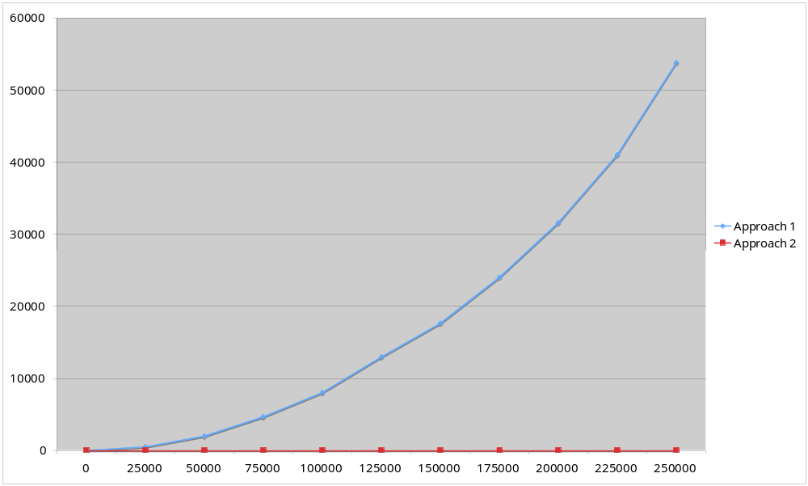
Example Chart

Slide 28
Analyse Results
As we can see, approach 1 is much slower than approach 2.
In fact, approach 1 seems to to take polynomial time whereas approach 2 seems to take linear time…
Anyway, we can see that, in general, approach 2 is clearly better than approach 1!
Isn’t that useful to know…

